Slide 1
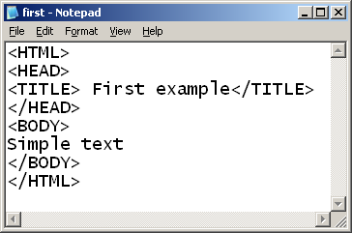
HTML pamati
Notepad vai Wordpad
bet ne Word (ASCII bet ne .doc)
File / Save As / first.html

Slide 2
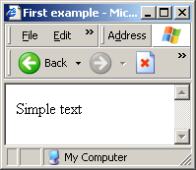
HTML pamati (2)
Pārlūkprogramma (Open browser)
File / Open / Browse / first / OK

Slide 3
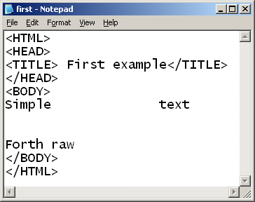
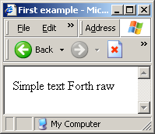
HTML pamati (3)

Slide 4
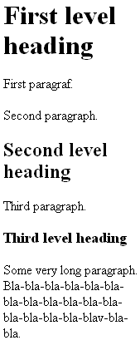
Virsraksti un rindkopas
<BODY><H1>First level heading</H1> <P>First paragraf.</P> <P>Second paragraph.</P>
<H2>Second level heading</H2> <P>Third paragraph.</P>
<H3>Third level heading</H3>
<P>Some very long paragraph. Bla-bla-bla-bla-bla-bla-bla-bla-bla-bla-bla-bla-bla-bla-bla-bla-blav-bla-bla. </P></BODY>
H1-H6 nav ievietoti cits citā

Slide 5
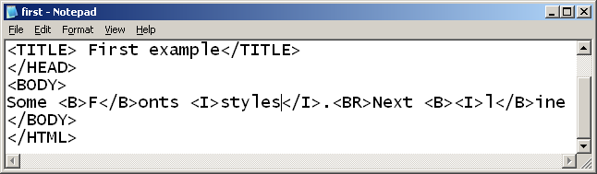
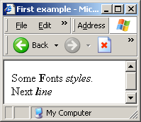
Teksta formatēšana

Slide 6
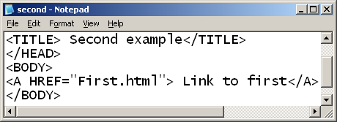
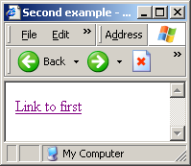
Hipersaite

Slide 7

Attēlos ievietošana
<IMG SRC="C:\tabhelp.gif">
<IMG SRC="C:\tabhelp.gif“ ALT="Help">
<IMG SRC="C:\tabhelp.gif" WIDTH=“80" HEIGHT=“20">

Slide 8


Attēls kā hipersaite
<A HREF="First.html">
<IMG SRC="C:\tabhelp.gif"> </A>
<A HREF="First.html">
<IMG SRC="C:\tabhelp.gif“
BORDER=“0”> </A>

Slide 9



Krasa, Fonts un Līdzināšana
<FONT COLOR="red">Text in red.</FONT> <FONT FACE="Arial, Verdana, Helvetica">In any mentioned above fonts.</FONT>
<P ALIGN="center">This is center</P>

Slide 10
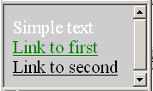
Lapu īpašības
<BODY BGCOLOR="#CDCDCD" TEXT="white“
LINK="green" ALINK="black" VLINK="red">
Simple text
<A HREF="First.html"> Link to first</A>
<A HREF="Second.html"> Link to second</A>
</BODY>

Slide 11
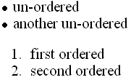
Saraksti
<UL> <LI>un-ordered <LI>another un-ordered </UL>
<OL> <LI>first ordered <LI>second ordered </OL>
<UL TYPE=“{ disc (default) | square | circle }” …>
<OL TYPE=" { 1 (default) | a | A | i | I }"...>

Slide 12
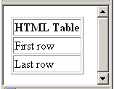
Tabulas
<TABLE BORDER="1">
<TR> <TH>HTML Table</TH> </TR>
<TR> <TD>First row</TD> </TR>
<TR> <TD>Last row</TD> </TR>
</TABLE>

Slide 13
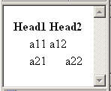
Tabulas (2)
<TABLE> <TR><TH>Head1</TH> <TH>Head2</TH> </TR><TR><TD ALIGN="RIGHT"> a11</TD><TD>a12</TD></TR>
<TR ALIGN="RIGHT">
<TD>a21</TD>
<TD>a22</TD></TR>
</TABLE>
Parametra BORDER nav

Slide 14
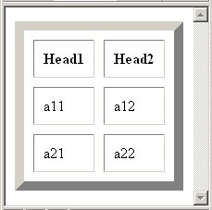
Tabulas (3)
<TABLE BORDER="10" CELLSPACING="10" CELLPADDING="10">
…
</TABLE>

Slide 15
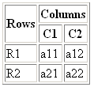
Tabulas (4)
<TABLE BORDER="1">
<TR><TH ROWSPAN="2">Rows
<TH COLSPAN="2">Columns
<TR><TH>C1<TH>C2
<TR><TD>R1<TD>a11<TD>a12
<TR><TD>R2<TD>a21 <TD>a22
</TABLE>

Slide 16



Tabulas (5)
<TR><TD>R2<TD>a21 <TD >a22 a22 a22
<TR><TD>R2<TD>a21 <TD WIDTH="10">a22 a22 a22
<TR><TD VALIGN="TOP">R2 <TD>a21 <TD WIDTH="10">a22 a22 a22

Slide 17
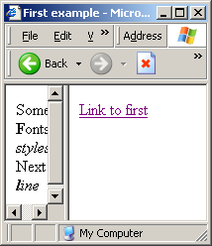
Freimi (Frames)
<HTML> <HEAD><TITLE>Frame example</TITLE></HEAD> <FRAMESET COLS=“30%,*"> <FRAME SRC="first.html"> <FRAME SRC="second.html"> </FRAMESET> </HTML>

Slide 18
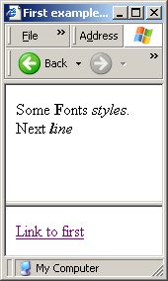
Freimi (2)
<FRAMESET ROWS=“70%,*">

Slide 19
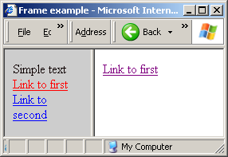
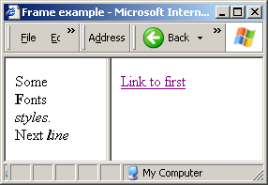
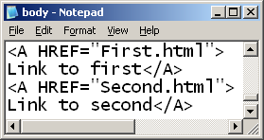
Freimi (3)
<FRAMESET COLS=“40%,*">
<FRAME SRC="body.html">
<FRAME SRC="second.html" NAME="Otrais">
</FRAMESET>

Slide 20
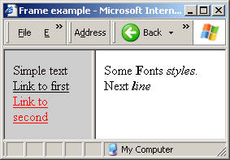
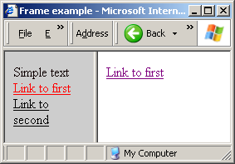
Freimi (4)
body.html …
<A HREF="First.html" TARGET="Otrais">
Link to first</A>
<A HREF="Second.html" TARGET="Otrais">
Link to second</A>
<FRAME
SRC="second.html“
NAME="Otrais">

Slide 21
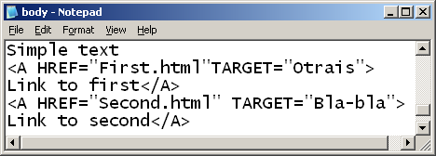
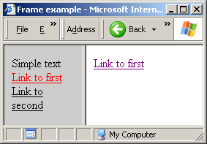
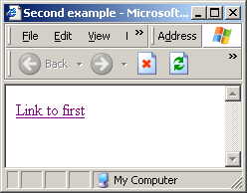
Freimi (5)

Slide 22
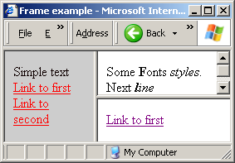
Freimi (6)
<FRAMESET COLS="40%,*">
<FRAME SRC="body.html">
<FRAMESET ROWS="50%,*">
<FRAME SRC="first.html">
<FRAME SRC="second.html">
</FRAMESET>
</FRAMESET>

Slide 23
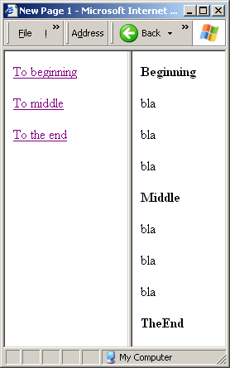
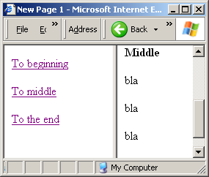
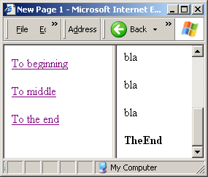
Grāmatzīmes (bookmarks)

Slide 24
Grāmatzīmes (2)
<a name="Mid"></a>Middle
<a href="Right.htm#Mid">To middle</a>

Slide 25
Grāmatzīmes (3)
<a href="Right.htm#End">To the end</a>
<a name="End"></a>TheEnd

Slide 26

Stili (Styles)
<head> <style>
<!-- span.Selection { font-family: Umbra TL } -->
</style> </head>
<body> ...
<span class="Selection">bla</span> ...
</body>

Slide 27


Stili (Cascading Style Sheet – CSS)
File / New
span.Keyword { font-style: italic; font-weight: bold }
File / Save As / MyStyles.css
File / ...
<head> <link rel="stylesheet“
type="text/css“
href="MyStyles.css">
</head> <body>...
<span class="Keyword">
bla</span> ... </body>

Slide 28
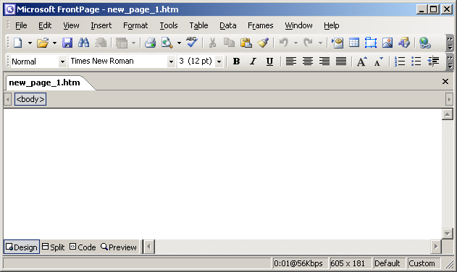
FrontPage 2003

Slide 29
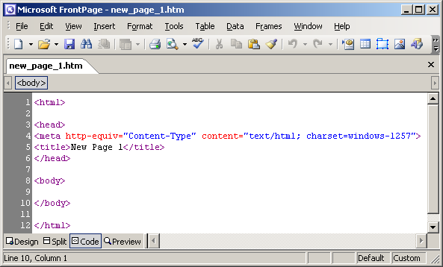
FrontPage (2)

Slide 30
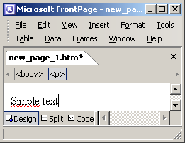
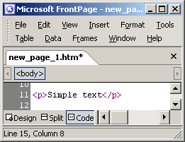
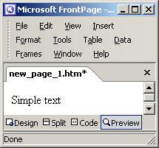
Teksts

Slide 31
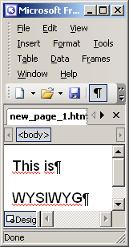
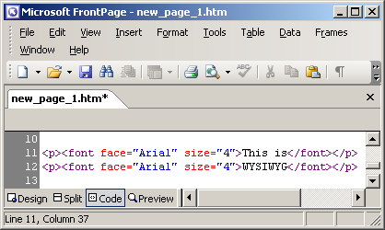
Formāts un rindkopas
Format / Font / 4 (14pt) / Arial / This is ¶ WYSIWYG

Slide 32
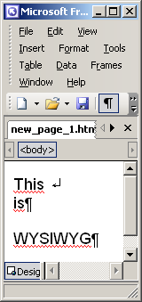
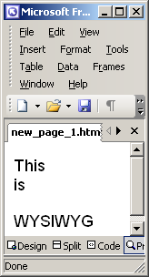

Rindkopas un rindas
Insert / Break / Normal line break

Slide 33
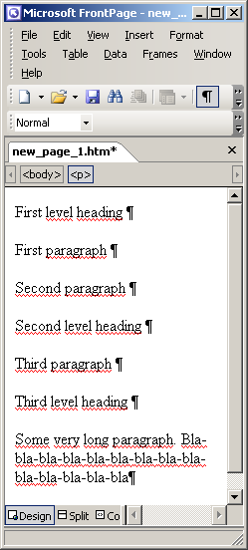
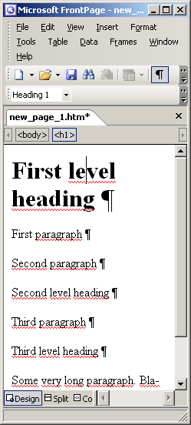
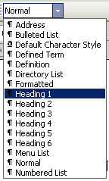
Teksta formatēšana

Slide 34
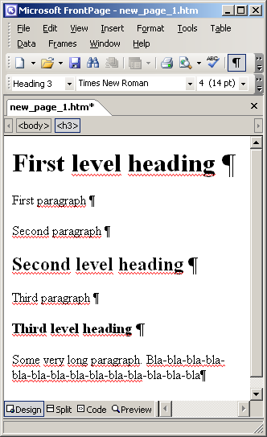
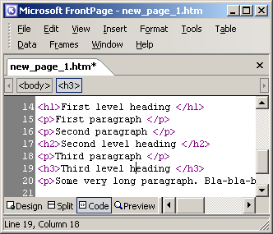
Teksta formatēšana (2)

Slide 35
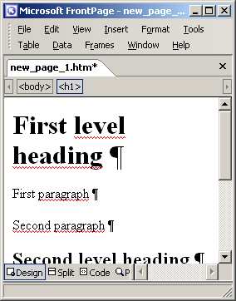
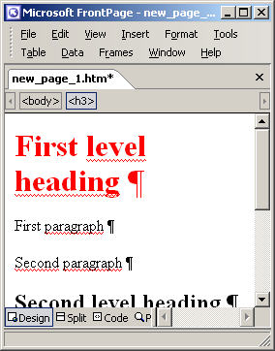
Teksta formatēšana (3)
Format / Style / h1 / Modify / Format / Font / Color: Red / OK

Slide 36
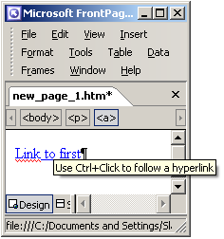
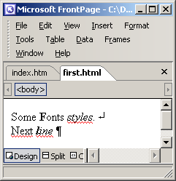
Hipersaite
Insert / Hyperlink / Text to display: Link to first /
Look in: C:\first.html / OK

Slide 37
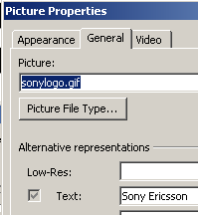
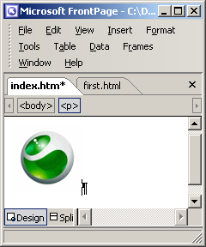
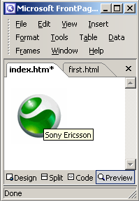
Attēlos ievietošana
Insert / Picture / From file / Look in: C:\sonylogo.gif / Insert
Right click / Picture Properties

Slide 38

Attēlos rediģēšana
Right click / Show Picture Toolbar

Slide 39


Attēls kā hipersaite
Picture properties / General / Default hyperlink: Location: C:\first.html / OK
☺

Slide 40

Lapu īpašības
<Right click> / Page properties /
Formatting /
Colors:
Background: gray
Hyperlink: green
Text: white
Visited hyperlink: red
Active hyperlink: black /
OK

Slide 41

Saraksti
<ul> <li>Un-ordered</li> <li>another un-ordered</li> </ul>
<ol> <li>first ordered</li> <li>second ordered</li> </ol>

Slide 42


Saraksti (2)
<Right click> / List properties
Format / Style / ul / Modify / Format / Numbering

Slide 43

Tabulas
Table / Insert / Table / Size: Rows: 3 / Columns: 1 / Specify width: 100 / In percent / OK

Slide 44


Tabulas (2)

Slide 45
Tabulas (3)
<Right click> / Cell properties / Layout: Header cell / OK
Horizontal alignment:
Vertical alignment:
Specify height:

Slide 46




Tabulas (4)
Table / Insert / Table / Size: Rows:4 / Columns:3
Table / Merge cells
Table / Merge cells

Slide 47

Freimi (Frames)
File / New / More pages templates /
Frames pages /
Nested hierarchy
<Click> Look in: … body.html
<Click> Look in: … first.html
<Click> Changing text

Slide 48


Freimi (2)

Slide 49




Freimi (3)
<Right click> Frame properties

Slide 50



Freimi (4)
<Right click> Hyperlink properties / Target frame

Slide 51


Freimi (5)
<Right click> Hyperlink properties / Look in: Body

Slide 52

Freimi (6)
File / SaveAs

Slide 53



Freimi (7)

Slide 54




Grāmatzīmes
Insert / Bookmark / Bookmark name: Mid
Insert / Hyperlink ...

Slide 55

Stili
Format / Style / New /
Name: Keyword /
Style type: Character /
Format / Font …

Slide 56
Cascading Style Sheet – CSS
File / New / More pages templates / Style Sheets / Normal Style Sheet
Format / Style / New / Name: Selection /
Style type: Character / Format / Font / Umbra TL
File / Save As / CommonStyles.css
File / Open / ...Format / Style Sheet Links/ Add /

Slide 57

CSS (2)
File / Open / ...
Format /
Style Sheet Links /
Add / CommonStyles.css

Slide 58

Uzdevums
File / MS Word 1.uzd.txt

Slide 59

Uzdevums (2)
Tikai uz HTML līmenī

Slide 60

Uzdevums (3)
Tikai uz HTML līmenī

Slide 61

Uzdevums (4)
Tikai uz HTML līmenī

Slide 62

Uzdevums (5)
Tikai uz HTML līmenī

Slide 63

Uzdevums (6)
Tikai uz HTML līmenī

Slide 64

Uzdevums (7)
Tālāk – pielietojot FrontPage

Slide 65

Uzdevums (8)
Tālāk – pielietojot FrontPage

Slide 66

Uzdevums (9)
Tālāk – pielietojot FrontPage

Slide 67

Uzdevums (10)
Tālāk – pielietojot FrontPage

Slide 68


Uzdevums (11)

Slide 69

Uzdevums (12)

Slide 70

Uzdevums (13)
Uz nākošu sadaļu

Slide 71

Uzdevums (14)
Uz iepriekšējo sadaļu

